Slide 1
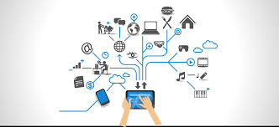
iCarat Technology
Micro service App In Eureka Server
Knowledge Sharing – Vishwanath
12th Aprl 2017

Slide 2
Agenda
iCarat Technology
Introduction of Microservice and Eureka
Features
Architecture
Technologies Used
Eureka Implementation Example

Slide 3
iCarat Technology
Microservice
Microservices is an architecture style, in which large complex software applications are composed of one or more services. Microservice can be deployed independently of one another and are loosely coupled. Each of these microservices focuses on completing one task only and does that one task really well. In all cases, that one task represents a small business capability. Figure 1-1 shows a sample application using microservices.
Also, microservices can be developed in any programming language. They communicate with each other using language-neutral application programming interfaces (APIs) such as Representational State Transfer (REST). Microservices also have a bounded context. They don’t need to know anything about underlying implementation or architecture of other microservices.

Slide 4
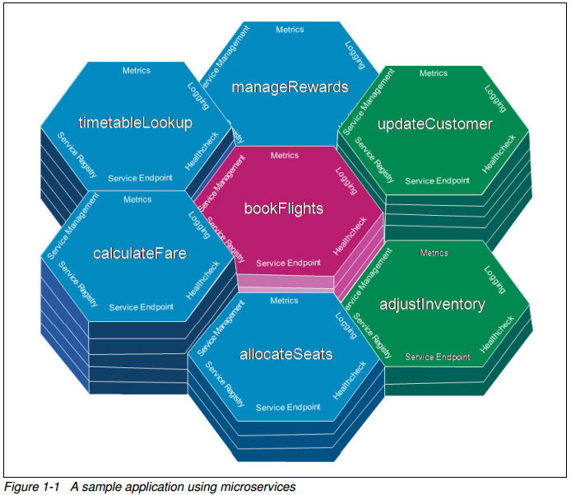
iCarat Technology

Slide 5
iCarat Technology
Microservice
Small and focused Microservices need to focus on a unit of work, and as such they are small. There are no rules on how small a microservice must be. You want to make the microservice small enough so that you can rewrite and maintain the entire microservice easily within a team if you need to.
Loosely coupled Loose coupling is an absolutely essential characteristic of microservices. You need to be able to deploy a single microservice on its own. There must be zero coordination necessary for the deployment with other microservices. This loose coupling enables frequent and rapid deployments, therefore getting much-needed features and capabilities to the consumers.
Language-neutral Microservices are composed together to form a complex application, and they do not need to be written using the same programming language. In some cases Java might be the correct language, and in others it might be Python
Bounded context as What we mean by bounded context is that a particular microservice does not “know” anything about underlying implementation of other microservices surrounding it. If for whatever reason a microservice needs to know anything about another microservice (for example, what it does or how it needs to be called), you do not have a bounded context.

Slide 6
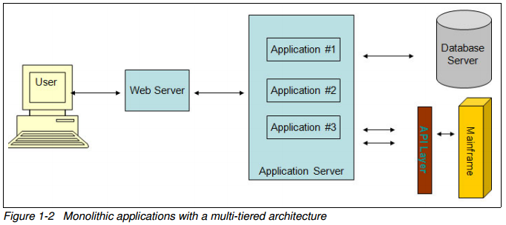
iCarat Technology
Monolithic app?
A monolithic application is an application where all of the logic runs in a single app server. Typical monolithic applications are large and built by multiple teams, requiring careful orchestration of deployment for every change. We also consider applications monolithic if, while there are multiple API services providing the business logic, the entire presentation layer is a single large web app. In both cases, microservice architecture can provide an alternative.

Slide 7
Monolithic v/s Micro
iCarat Technology
Category | Monolithic architecture | Microservices architecture
Code | A single code base for the entire application. | Multiple code bases. Each microservice has its own code base.
Understandability | Often confusing and hard to maintain. | Much better readability and much easier to maintain.
Deployment | Complex deployments with maintenance windows and scheduled downtimes. | Simple deployment as each microservice can be deployed individually, with minimal if not zero downtime.
Language | Typically entirely developed in one programming language | Each microservice can be developed in a different programming language.
Scaling | Requires you to scale the entire application even though bottlenecks are localized. | Enables you to scale bottle-necked services without scaling the entire application.

Slide 8
Microservices Benefits
iCarat Technology
Developer perspective
Enables you to avoid large code base,making it easier to maintain or add to features
Makes it easier to use existing skills, or the most optimal languag
Improves deployment times and load times for IDE
Makes debugging easier
Enables teams to work more independently of each other
Simplifies tracking code dependencies
Enables complete ownership by a self-contained single team, from definition through development, deployment, operations, and sunsetting
Makes it easier to scale bottlenecks 1.2.4

Slide 9
Microservices Benefits
iCarat Technology
Tester perspective
Testing times tend to slow down with large applications, because they take unreasonably longer times to start, leading to lower tester productivity. Every time there is a change to the code that requires a container to reload or restart, testers become less productive.
There is also an issue of single point of dependence when multiple test teams are running their test cases. For any incremental change to components, the entire container must be reloaded or restarted, regardless of the size and scope of the changes. Similarly, defects have a greater chance of blocking more team members from testing compared to a microservice.
With monolithic applications, even a small change might have a large ripple effect with regards to regression testing. Typically, monolithic applications require a built up history of a large suite of regression tests. This adds to testing time cycles and adds to the number of testers required to complete testing. In some cases, there is also a risk of false positives showing up from findings unrelated to the specific change being tested.

Slide 10
Microservices Benefits
iCarat Technology
Business owner perspective
Business owners want their teams to be able to respond to new customer and market needs. Microservices allows for more frequent delivery and faster delivery times. This enables business owners to get quicker feedback, and make adjustments to their investments.
Microservices allow you to have smaller focused teams that align with business revenue and cost centers. That enables business owners to more easily see where their resources are allocated, and to move them from low impact business areas to new or higher impact business areas..

Slide 11
iCarat Technology
Technologies Used
Maven - Project Build Environment
Spring Boot 1.5.1
Java 8.0
Eureka

Slide 12
iCarat Technology
Spring cloud Netflix
The microservice style of architecture is not so much about building individual services so much as it is making the interactions between services reliable and failure-tolerant. While the focus on these interactions is new, the need for that focus is not. We’ve long known that services don’t operate in a vacuum. Even before cloud economics, we knew that - in a practical world - clients should be designed to be immune to service outages. The cloud makes it easy to think of capacity as ephemeral, fluid. The burden is on the client to manage this intrinsic complexity.
Netflix OSS is a set of frameworks and libraries that Netflix wrote to solve some interesting distributed-systems problems at scale. Today, for Java developers, it’s pretty synonymous with developing microservices in a cloud environment. Patterns for service discovery, load balancing, fault-tolerance, etc are incredibly important concepts for scalable distributed systems and Netflix brings nice solutions for these.

Slide 13
iCarat Technology
Eureka
Eureka is a REST (Representational State Transfer) based service that is primarily used in the AWS cloud for locating services for the purpose of load balancing and failover of middle-tier servers.
Basically, the Eureka infrastructure is set up as a client-server model. You can have one or multiple Eureka Servers and multiple Eureka Clients. It's a registry where clients (your microservices) can connect to (register), making your Eureka server aware of where your microservices are located, how many there are and if they're healthy or not.
Eureka Server : a server where microservices can register themselves so others can discover them. Is discovery server. It contains a registry of services and a REST api that can be used to register a service, deregister a service, and discover the location of other services.
Eureka Service: looks like when you register a microservice as an Eureka Client, you obtain an Eureka Service registered by an ID. Any application that can be found in the Eureka Server's registry and is discoverable by others. A service has a logical identifier sometimes called a VIP, sometimes called a "service id", that can refer to one or more instances of the same application.

Slide 14
iCarat Technology
Eureka
Eureka Instance: a single instance of a microservice (you can add more instances of the same microservice as your load grows i.e. horizontal scaling). Any application that registers itself with the Eureka Server to be discovered by others
Eureka Client: it can be a microservice that is ready to work so it registers itself to the Eureka server e.g. an API for some app, or some application that goes to the server and asks for directions to a specific microservice. Any application that can discover services

Slide 15
iCarat Technology
Eureka Implementaion
Eureka Server To implement a Eureka Server for using as service registry is as easy as: adding spring-cloud-starter-eureka-server to the dependencies, enable the Eureka Server in a @SpringBootApplication per annotate it with @EnableEurekaServer and configure some properties. But we’ll do it step by step.

Slide 16
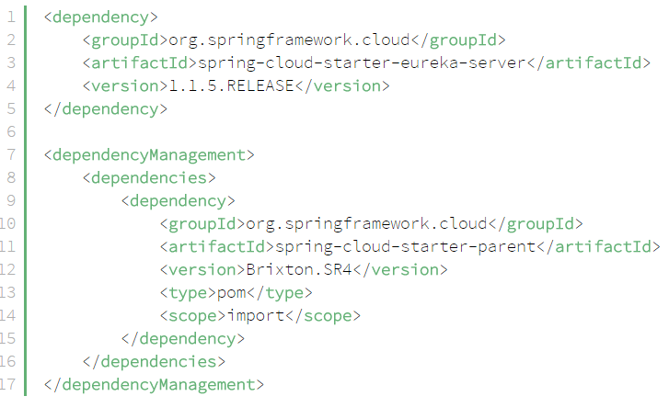
iCarat Technology
Eureka Implementaion
Step 1: Creating Discovery Service (Creating Eureka Discovery Service)
Firstly we’ll create a new Maven project and put the dependencies into it. You have to notice that we’re importing the spring-cloud-starter-parent to all projects described in this tutorial:

Slide 17
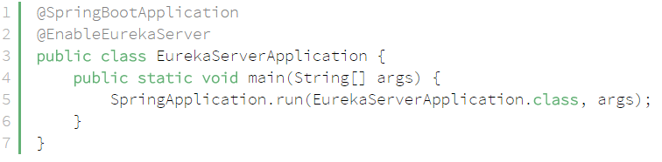
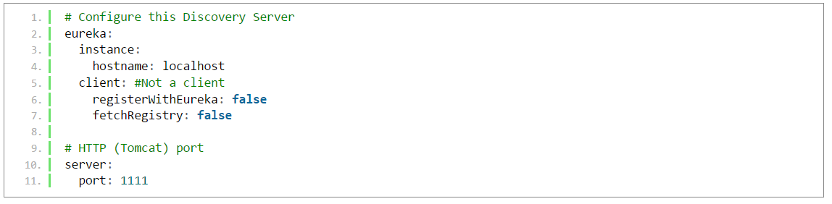
iCarat Technology
Eureka Implementaion
Next, we’re creating the main application class:
Finally, we’re configuring the properties in YAML format; so application.yml will be our configuration file:

Slide 18
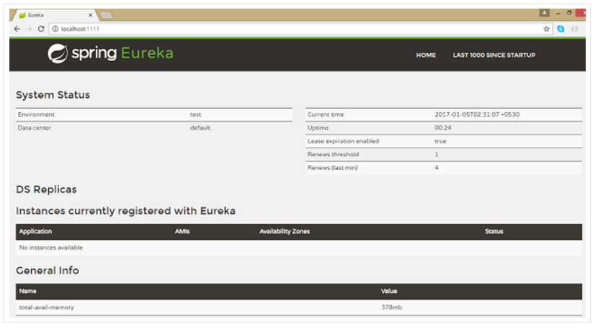
iCarat Technology
Eureka Implementaion
Run this Eureka Server application with right click and run as Spring Boot Application and open in browserhttp://localhost:1111 https://github.com/dineshonjava/discovery-microservice-server code for step1

Slide 19
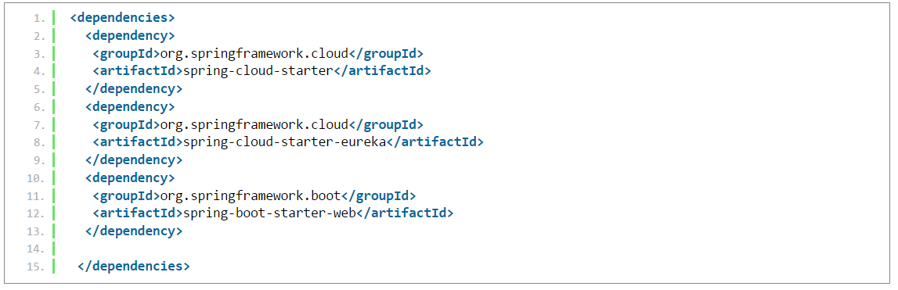
iCarat Technology
Eureka Implementaion
Step 2: Creating Account Producer MicroService
Eureka ClientFor a @SpringBootApplication to be discovery-aware, we have to include some Spring Discovery Client (for example: spring-cloud-starter-eureka) into our classpath.Then we need to annotate a @Configuration with either @EnableDiscoveryClient or @EnableEurekaClient.The latter tells Spring Boot to explicitly use Spring Netflix Eureka for service discovery. To fill our client application with some sample-life, we’ll also include the spring-boot-starter-web package in the pom.xml and implement a REST controller.
But first, we will add the dependencies:

Slide 20
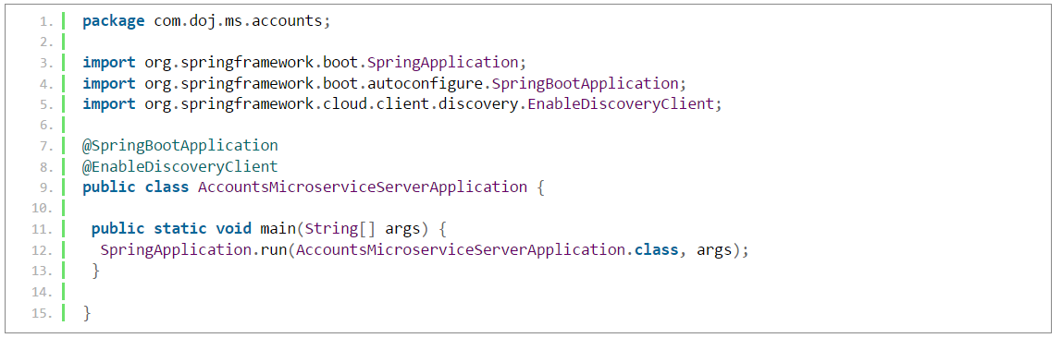
iCarat Technology
Eureka Implementaion
Here we will implement the main application class:

Slide 21
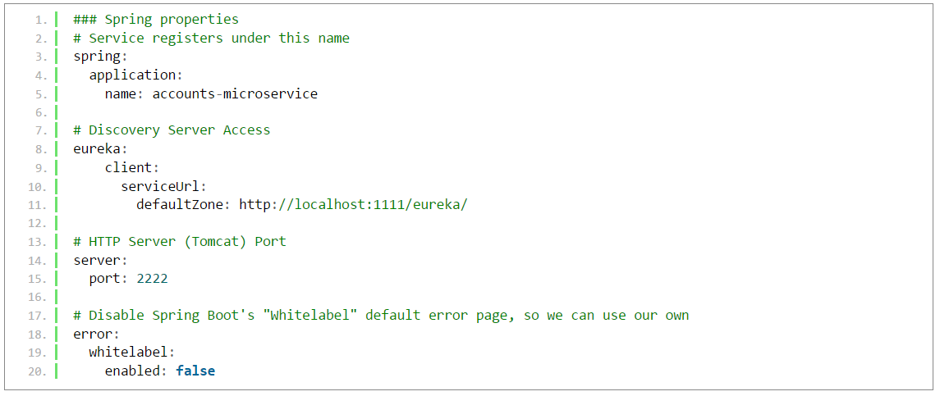
iCarat Technology
Eureka Implementaion
application.yml

Slide 22
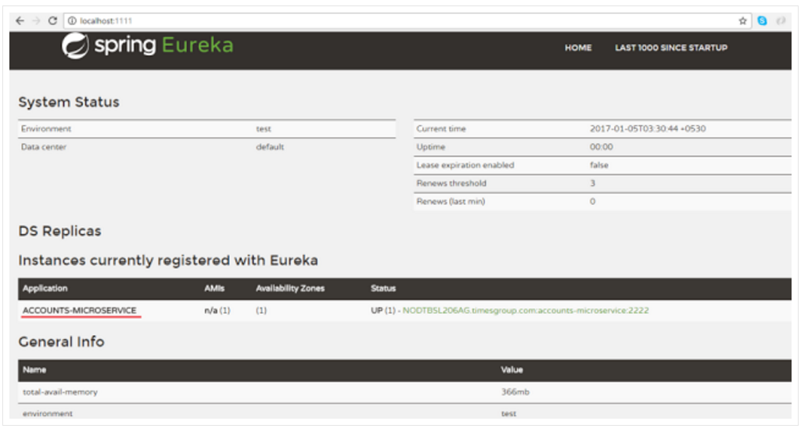
iCarat Technology
Eureka Implementaion
Now run this account service application as Spring Boot application and after few seconds refresh browser to the home page of Eureka Discovery Server at http://localhost:1111/ in previous Step 1. https://github.com/dineshonjava/accounts-microservice-server code for step2

Slide 23
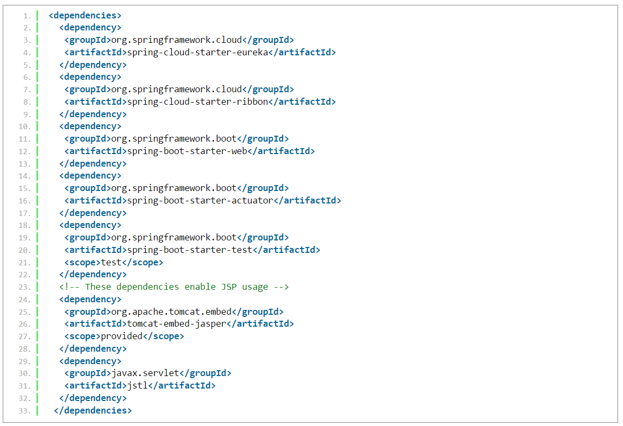
iCarat Technology
Eureka Implementaion
Step 3: Consumer Service
Create Consumers to find the Producer Service registered with Discovery Service at Step 1.@EnableDiscoveryClient annotation also allows us to query Discovery server to find miroservices.

Slide 24
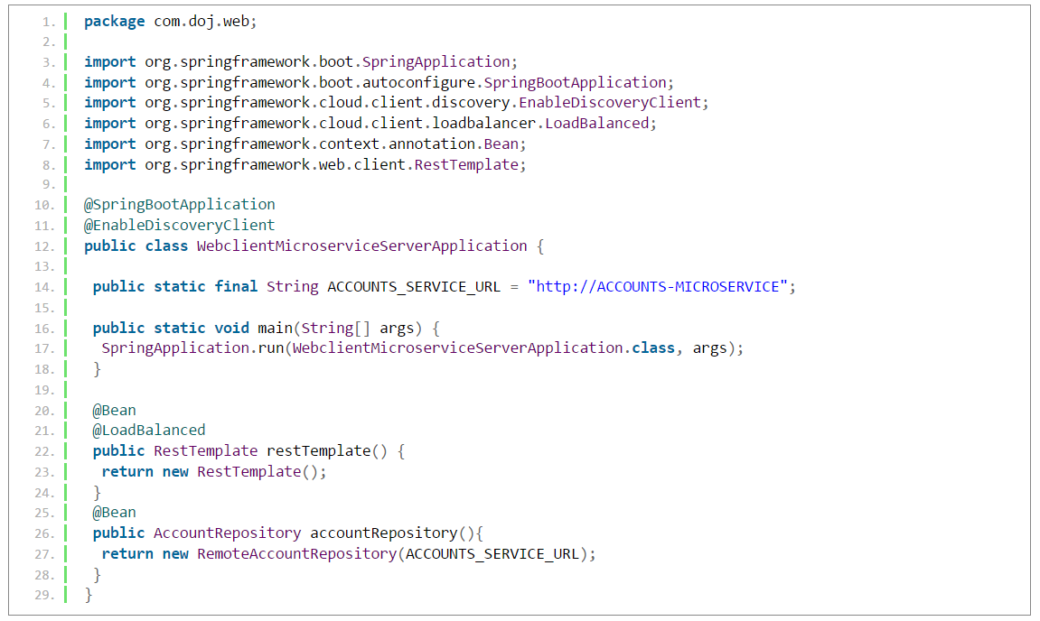
iCarat Technology
Eureka Implementaion
WebclientMicroserviceServerApplication.java

Slide 25
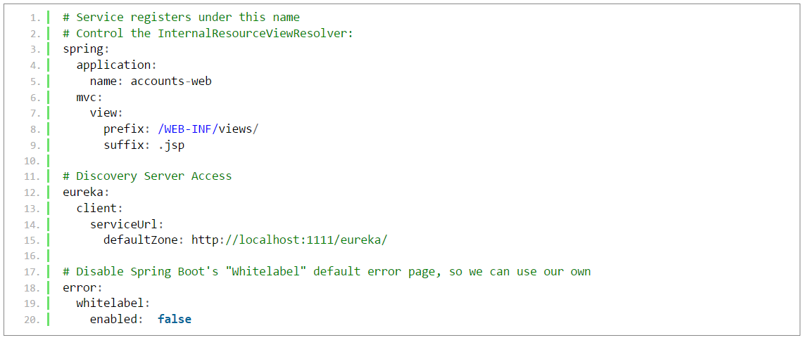
iCarat Technology
Eureka Implementaion
application.yml
Lets our consumer consume the service of producer registered at discovery server.

Slide 26
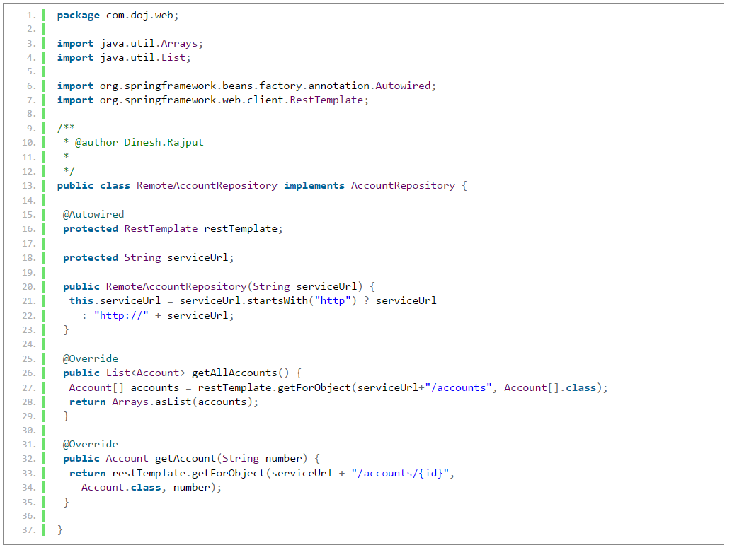
iCarat Technology
Eureka Implementaion

Slide 27
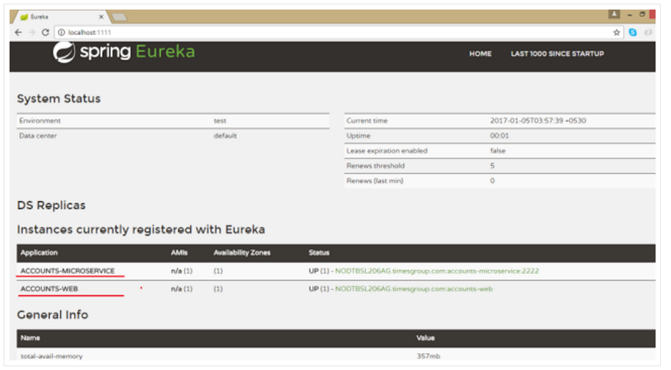
iCarat Technology
Eureka Implementaion
Now run this consumer service application as Spring Boot application and after few seconds refresh browser to the home page of Eureka Discovery Server at http://localhost:1111/ in previous Step 1. Now one more Service registered to the Eureka registered instances with Service Name "ACCOUNTS-WEB" as below

Slide 28
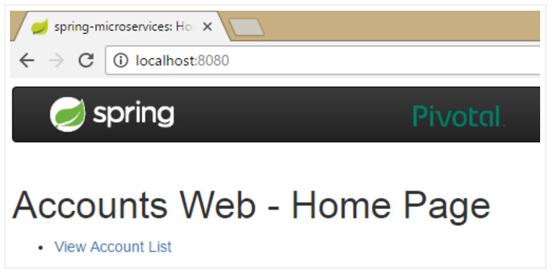
iCarat Technology
Eureka Implementaion
Lets open web application which is a consumer of the account microservice registered at Eureka Discovery Server. http://localhost:8080/ as below
https://github.com/dineshonjava/webclient-microservice-server code for step 3

